Slide 1
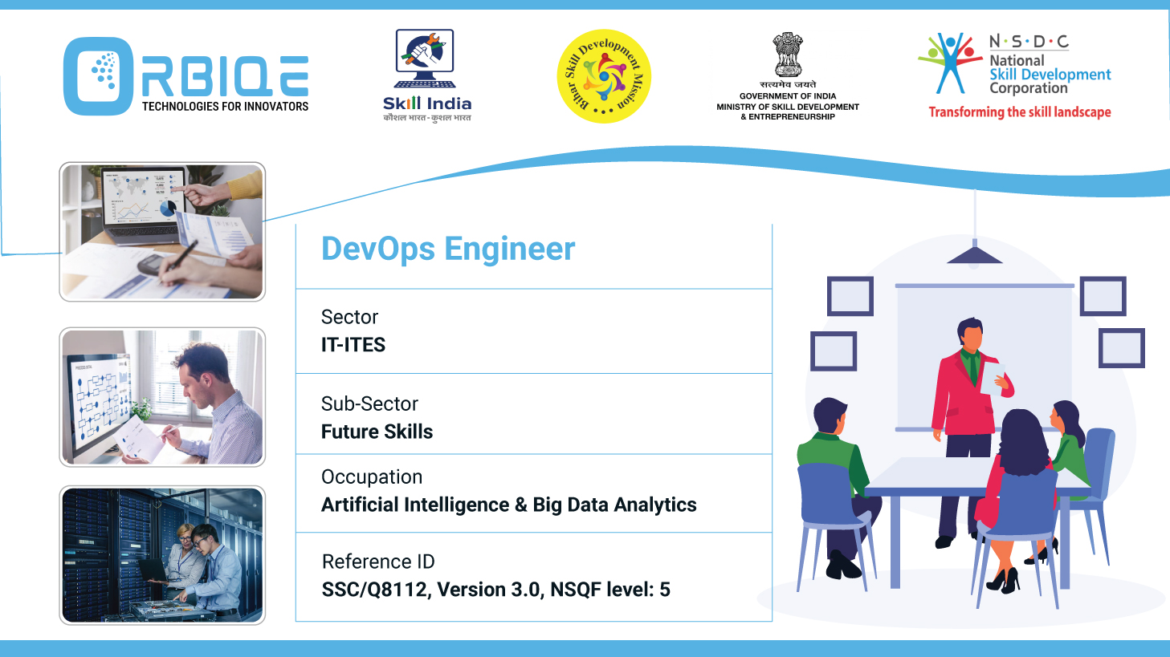
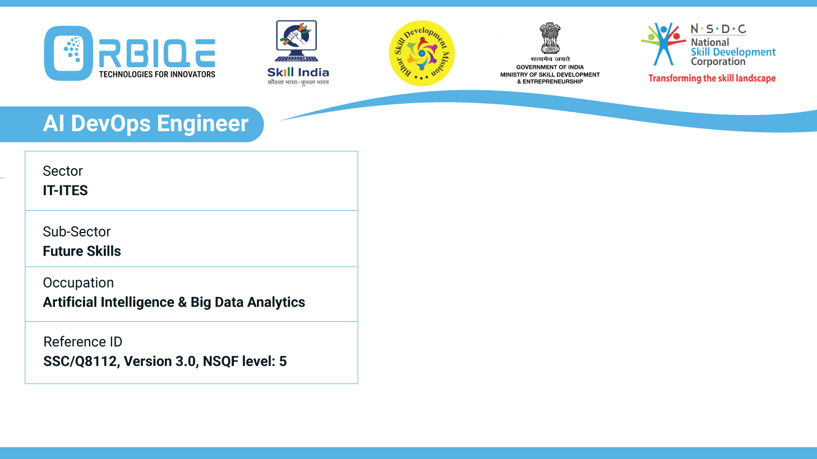
Name- Krishna Kant Dubey

Slide 2

Automating Excellence: Opportunities in Back-Up, Optimization, and Indexing

Slide 3
Agenda
Evaluate the opportunities of automation in back-up, optimization, and indexing procedures, enhancing efficiency and reliability in database management

Slide 4
Evaluation of the opportunities in each area
Automated Backup Procedures
Query Optimization Automation
Automated Indexing

Slide 5
Automated Backup Procedures
Opportunities
Scheduled Backups: Automate full, incremental, and differential backups based on usage patterns.
Intelligent Backup Frequency: AI can adjust backup intervals dynamically depending on data volatility.
Validation & Integrity Checks: Automatically verify backup completeness and consistency.
Disaster Recovery Automation: Trigger recovery workflows based on failure detection.

Slide 6
Automated Backup Procedures
Tools
AWS Backup, Azure Backup, Veeam, Rubrik
AI-enhanced platforms that predict optimal backup windows and detect anomalies
Benefits
Reduced human error
Faster recovery times
Improved compliance with data retention policies

Slide 7
Query Optimization Automation
Opportunities
AI-Driven Query Rewriting: Tools like SQLFlash and AI2SQL analyze and rewrite inefficient queries.
Execution Plan Tuning: ML models predict optimal join orders, indexing strategies, and parallelism.
Real-Time Adaptation: Systems like Azure SQL continuously tune performance based on workload changes.

Slide 8
Query Optimization Automation
Tools
SQL Server Intelligent Query Processing
Oracle Autonomous Database
AI2SQL, SQLFlash
Benefits
Up to 90% reduction in manual tuning effort
Faster query execution
Proactive performance management

Slide 9
Automated Indexing
Opportunities
Index Recommendations: AI suggests indexes based on query patterns and access frequency.
Dynamic Index Creation/Removal: Automatically adjust indexes as data and workloads evolve.
Index Health Monitoring: Detect fragmentation and trigger rebuilds or reorganizations.

Slide 10
Automated Indexing
Tools
SQL Server Database Engine Tuning Advisor
PostgreSQL’s and SQLFlash AI Indexing Engine
Benefits
Swift data retrieval
Reduced storage overhead
Elimination of redundant or unused indexes

Slide 11
Thank You

